Slide 1
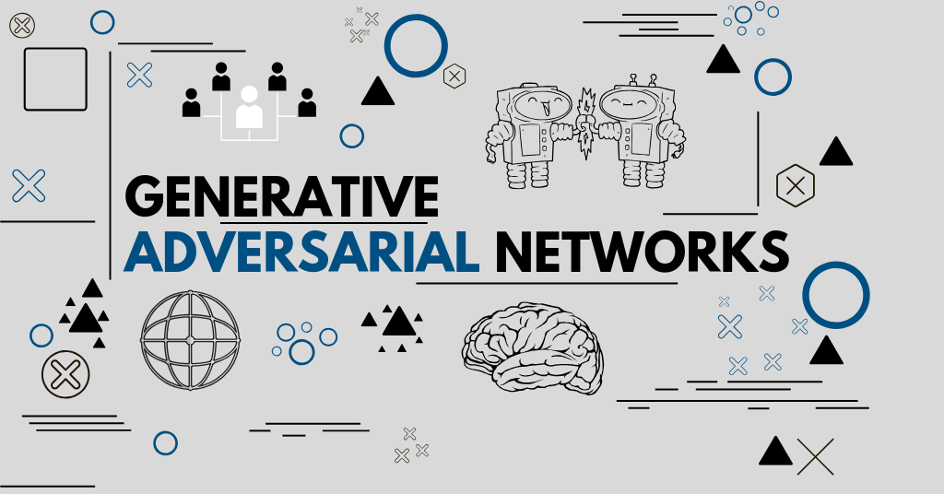
GAN and Generative Models
2020.12.18

Slide 2
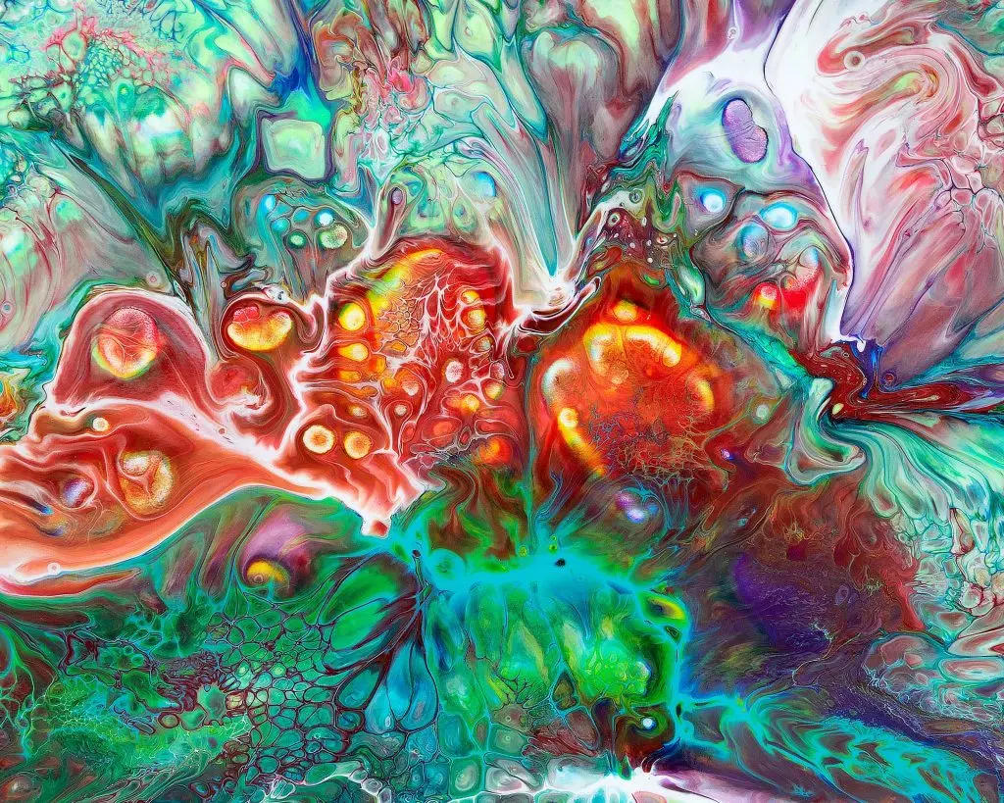
Outline
The Concept of GAN
Applications of GAN
Style Transfer
Deep Dream
Representation Learning
More on Generative Models

Slide 3
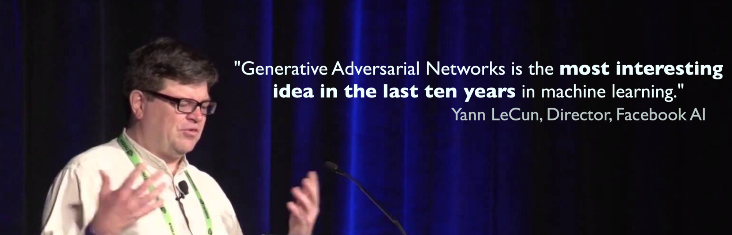
Generative Adversarial Networks
Goodfellow, Ian; Pouget-Abadie, Jean; Mirza, Mehdi; Xu, Bing; Warde-Farley, David; Ozair, Sherjil; Courville, Aaron; Bengio, Yoshua (2014). Generative Adversarial Networks. Proceedings of the International Conference on Neural Information Processing Systems (NIPS 2014). pp. 2672–2680.

Slide 4
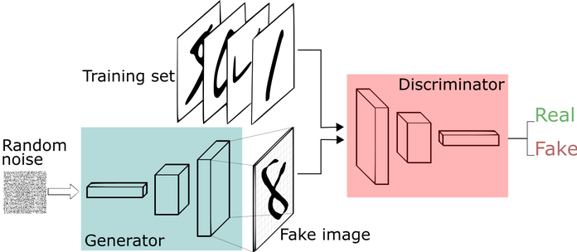
GAN: Concept
Two learning models compete to each other

Slide 5
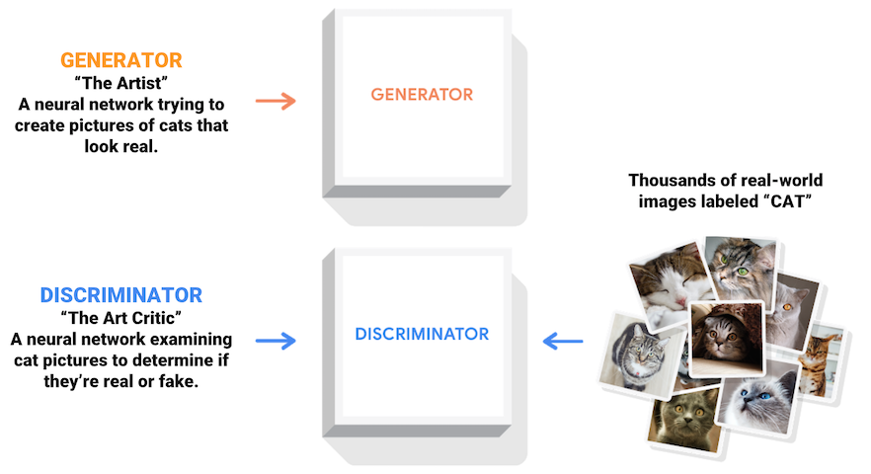
GAN: Artist vs Critics

Slide 6
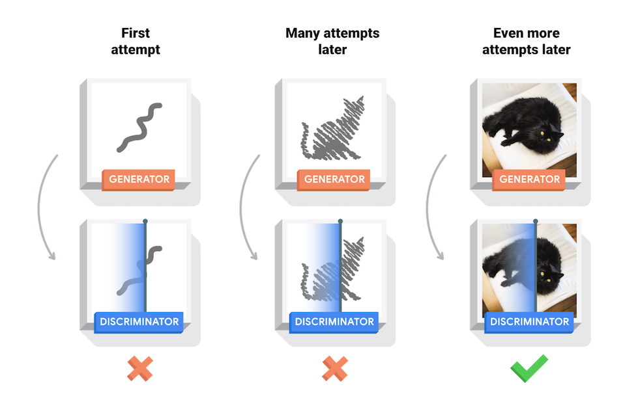
GAN: The Learning Process

Slide 7
GAN: The Algorithm

Slide 8
GAN: Generated Examples
Rightmost column shows the nearest training example of
the neighboring sample, in order to demonstrate that the model has not memorized the training set.

Slide 9
GAN: in the Original Paper
A clearly described algorithm and theorem
A derivation of (theoretical) global optimality
A proof of convergence of the algorithm
Well designed experiments
Comparison with other generative models
Goodfellow, Ian; Pouget-Abadie, Jean; Mirza, Mehdi; Xu, Bing; Warde-Farley, David; Ozair, Sherjil; Courville, Aaron; Bengio, Yoshua (2014). Generative Adversarial Networks. Proceedings of the International Conference on Neural Information Processing Systems (NIPS 2014). pp. 2672–2680.

Slide 10
GAN: Representation Learning
Deep Convolutional Generative Adversarial Networks (DCGANs, Radford, et al., 2016)
Radford, A., Metz, L., & Chintala, S. (2016). Unsupervised Representation Learning with Deep Convolutional Generative Adversarial Networks. ArXiv:1511.06434 [Cs]. http://arxiv.org/abs/1511.06434

Slide 11
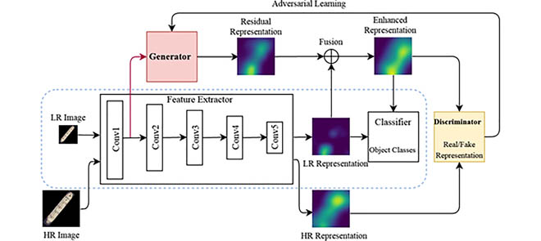
GAN: Representation Learning
Identifying tiny objects with extremely low resolution
Xi, Y., Zheng, J., Jia, W., He, X., Li, H., Ren, Z., & Lam, K. (2020). See Clearly in the Distance: Representation Learning GAN for Low Resolution Object Recognition. IEEE Access, 8, 53203–53214. https://doi.org/10.1109/ACCESS.2020.2978980

Slide 12
GAN: Representation Learning
BSD-GAN: Branched Generative Adversarial Network for Scale-Disentangled Representation Learning
Yi, Z., Chen, Z., Cai, H., Mao, W., Gong, M., & Zhang, H. (2020). BSD-GAN: Branched Generative Adversarial Network for Scale-Disentangled Representation Learning and Image Synthesis. ArXiv:1803.08467 [Cs]. http://arxiv.org/abs/1803.08467

Slide 13
GAN: Other Applications

Slide 14
Generative Models

